Slide 1


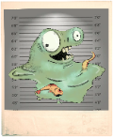
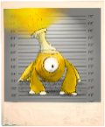
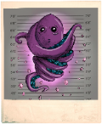
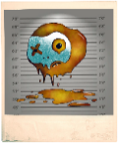
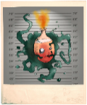
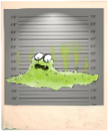
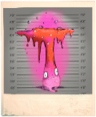
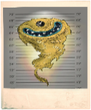
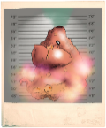
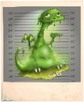




BRIEFING
Game
Co-funded by the European Union Civil Protection

Slide 2

Context and objectives of the game
Lack of knowledge about the HNS (Hazardous and Noxious Substances) behaviour:
→ need to raise awareness of crisis actors to better prepare them for the management of marine pollution by HNS
Proof of concept of a crisis management game for maritime HNS pollution

Slide 3
« Discovery » game
Context and objectives of the game
Serious game NIOVELIUS
Theoretical courses
Crisis exercise
Discovering, learning
Remebering by echoing
Reinvesting knowledge in action
"mise en bouche", awareness, preparation
crisis management phases
understanding the issues related to pollutants discharged into the seawater
collaborative work involving reflection

Slide 4





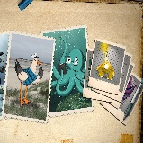

Main features of the game
Fictional universe
15 min briefing
Team of 4 players
2 hours of play
Total playing time: 3 h
45 min debriefing
Detective game
Half investigation – half escape game
Several teams can play simultaneously
1 facilitator
for briefing/debriefing
Hybrid format

Slide 5
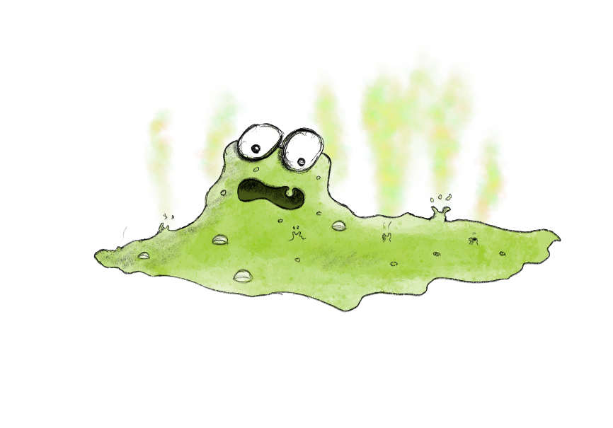

Story
You will be immersed into a fictional world in which chemicals are dangerous criminals:
For example, the Phosphoric Acid Gang, escaped spectacularly in 2006 and 10,000 pollu-criminals savagely attacked the marine resources and human in their path.

Slide 6
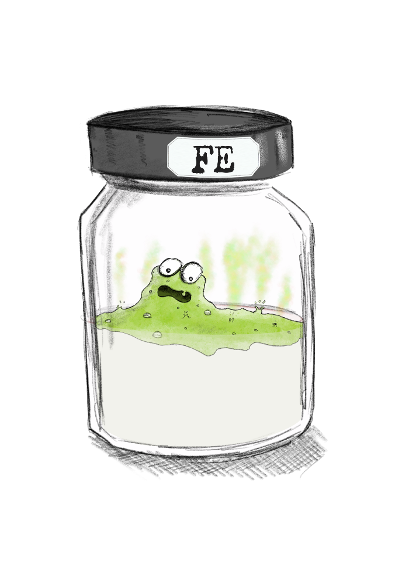
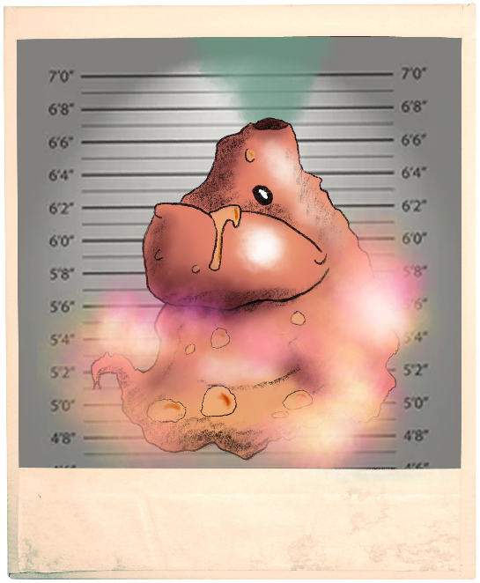
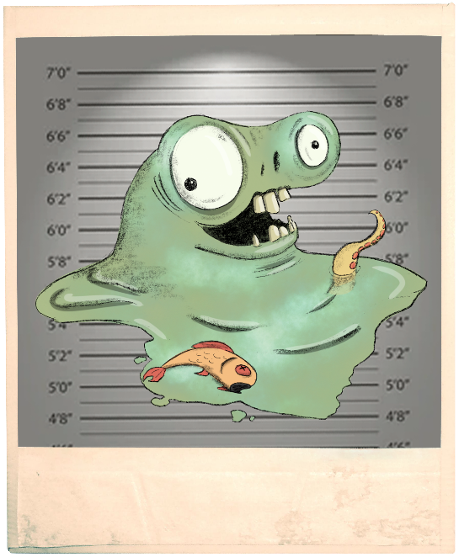
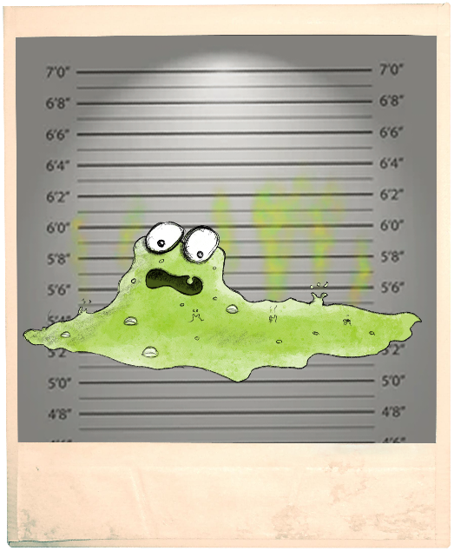
Story
To combat these pollu-criminals, a special academy recruits officers each year on the basis of their investigative skills.

Slide 7

Story
You have been spotted by this academy!
But before being recruited, you must prove yourself...

Slide 8


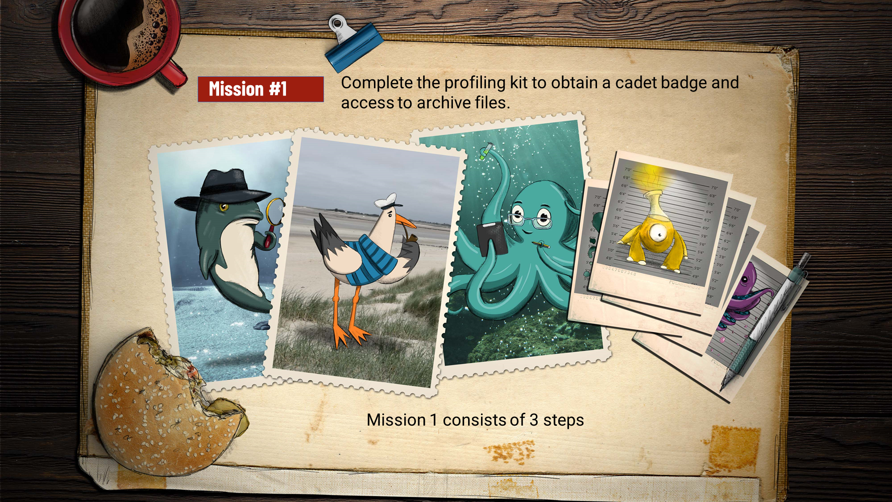
Playing rules
You will not be allowed to leave the room before the end of the game, nor will you be allowed to answer your phones (unless there is a compelling reason).
Different types of physical materials are available (envelopes, erasable markers, …). Only the material provided can be used.
Niovelius game

Slide 9

Playing rules
You also have a computer with the specific Niovelius app. (no internet access).
The digital tool is used :
1/ to guide you to know what you have to do;
2/ to listen to audio documents;
3/ to validate the solutions and codes of the puzzles.
✓
The physical documents are used to solve the puzzles.

Slide 10
Playing rules
It is up to you to discover the material available and to deduce how to build your investigation table to profile the pollu-criminals you are going to track down.
Remember that an investigation is always a team effort!

Slide 11
Playing rules
“We are being watched...”
Don't be surprised if you are observed during this test. The academy has called in a team of psychologists to observe your actions and optimise the relevance of the test. They have orders not to communicate with you.

Slide 12
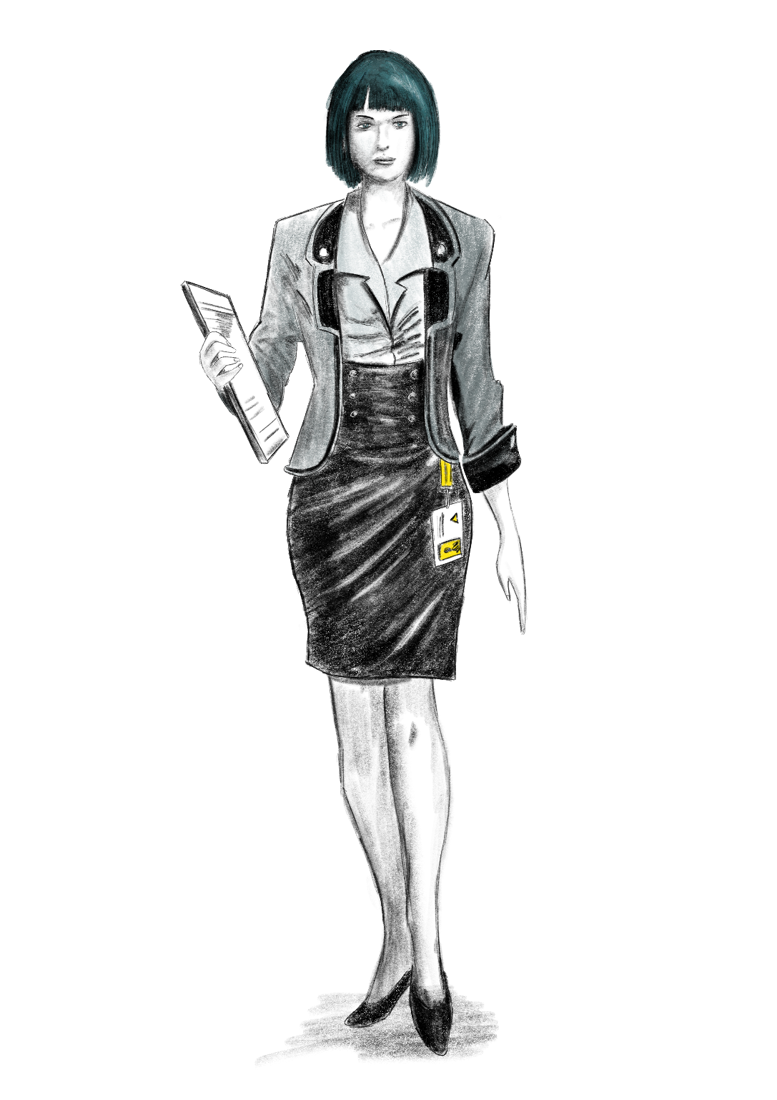
Any questions?
It's up to you...
... a recruiter is waiting for you at the academy

